Slide 1
Final Project
Bowen Su

Slide 2
Hypothesis
The age of football players has a negative correlation with the salary, so older players get lower salary

Slide 3
Data Source
https://docs.google.com/spreadsheets/d/18eFUrgZCiJhkrS3hiNB7W1rxXaU7hVjWtW662KSY4Y0/edit#gid=0

Slide 4
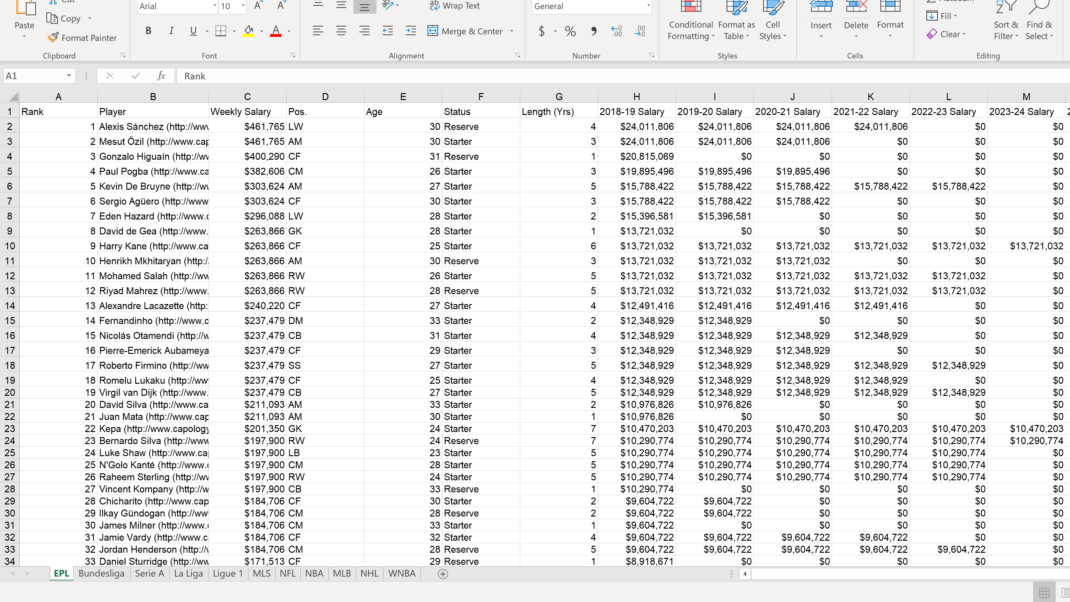
Raw Data

Slide 5
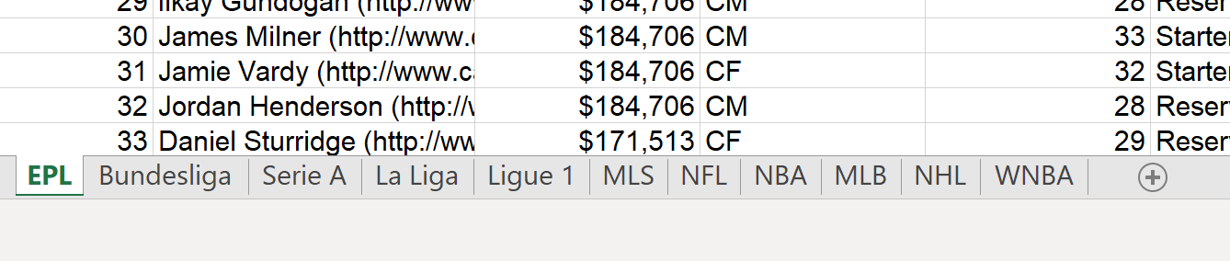
Too many leagues

Slide 6


Slide 7

Highest Salary
Alexis Sánchez
$461,765/week
Age: 30
Club: Manchester United

Slide 8
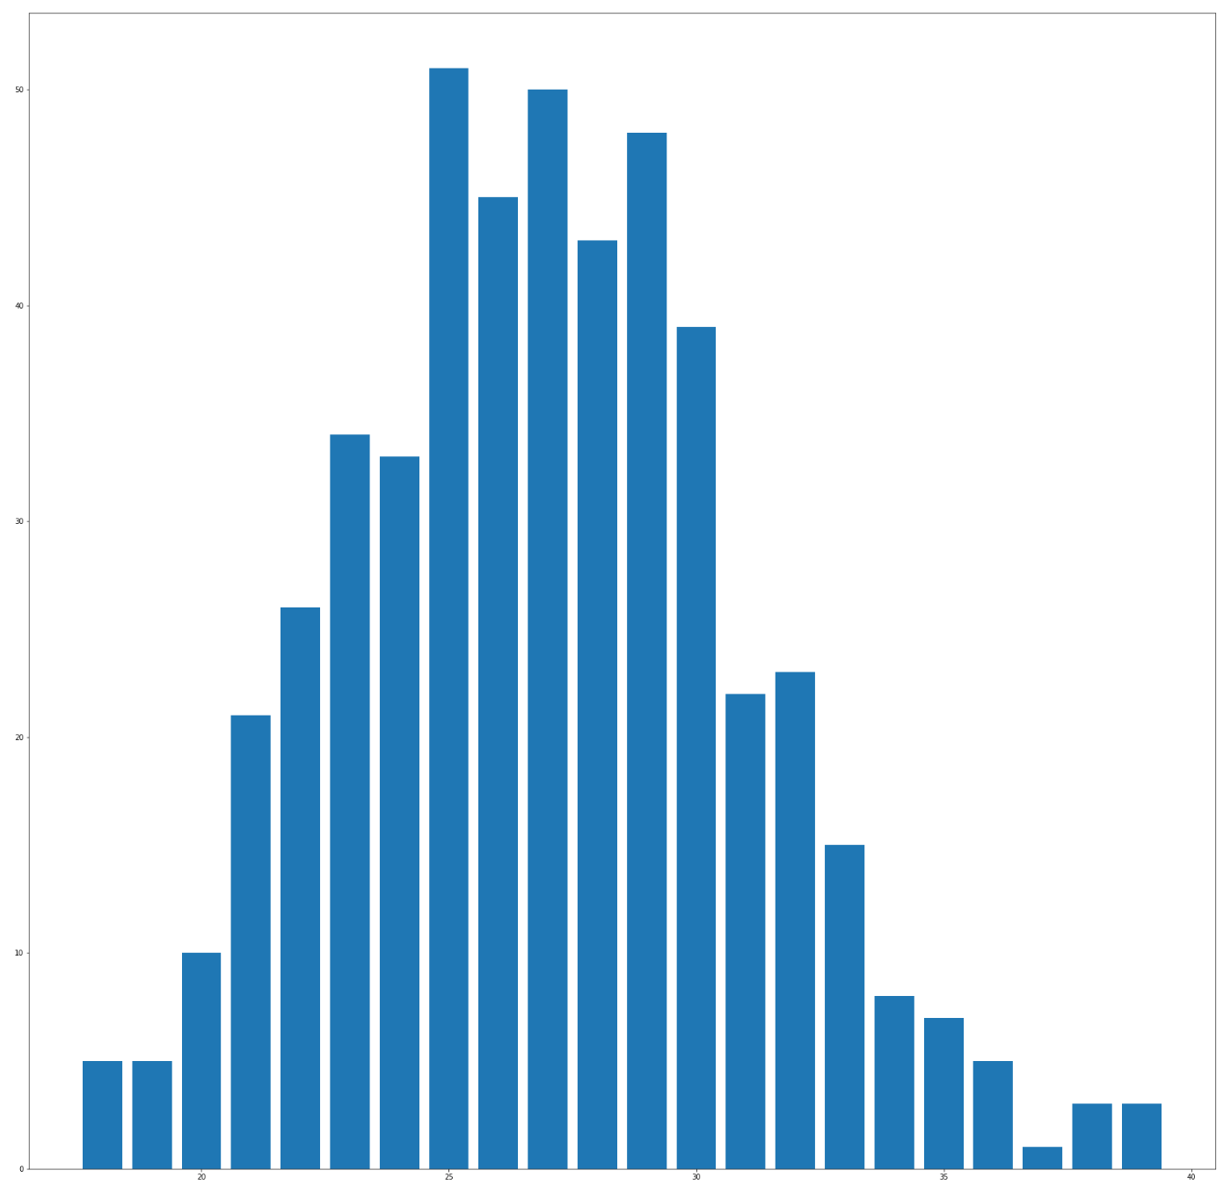
Age Distribution
Most players are between 20 to 35
Over 50% players are between 25 to 30

Slide 9
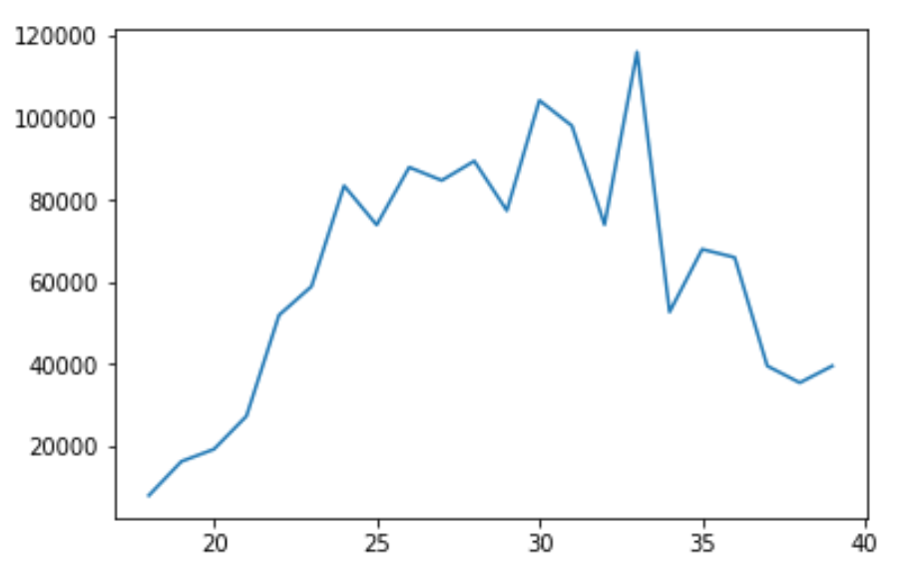
Average Salary
There is an increasing form ages 20 to 32
Then falls dramatically
In my opinion, it is a balance between physical fitness and experience when players reach 32 so they have highest average salary.

Slide 10
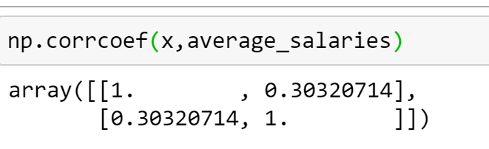
Hypothesis Rejected

Slide 11
Thanks

